Slide 1
DISASTER MANAGEMENT
IN INDIA

Slide 2
What is a Disaster?
A disaster is defined as a disruption on a massive scale, either natural or man-made, occurring in short or long periods. Disasters can lead to human, material, economic or environmental hardships, which can be beyond the bearable capacity of the affected society. As per statistics, India as a whole is vulnerable to 30 different types of disasters that will affect the economic, social, and human development potential to such an extent that it will have long-term effects on productivity and macro-economic performance.

Slide 3
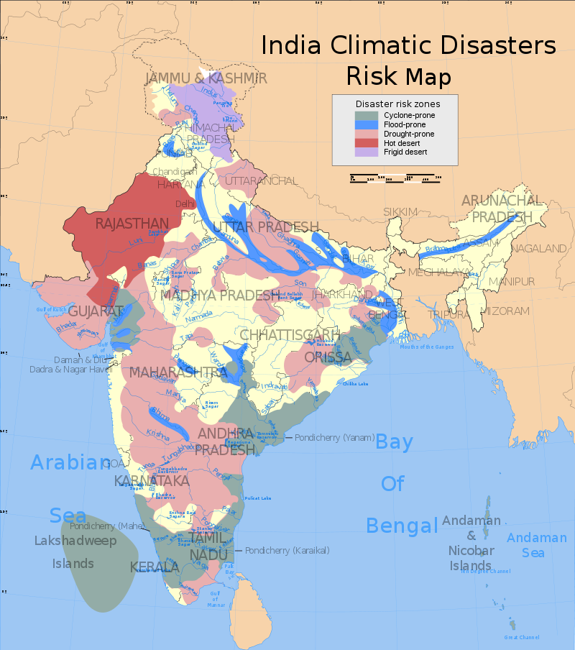

Slide 4
Disasters can be classified into the following categories:
Water and Climate Disaster: Flood, hail storms, cloudburst, cyclones, heat waves, cold waves, droughts, hurricanes.
Geological Disaster: Landslides, earthquakes, volcanic eruptions, tornadoes
Biological Disaster: Viral epidemics, pest attacks, cattle epidemic, and locust plagues
Industrial Disaster: Chemical and industrial accidents, mine shaft fires, oil spills,
Nuclear Disasters: Nuclear core meltdowns, radiation poisoning
Man-made disasters: Urban and forest fires, oil spill, the collapse of huge building structures

Slide 5
What is Disaster Management?
The Disaster Management Act of 2005 defines Disaster Management as an integrated process of planning, organizing, coordinating and implementing measures which are necessary for-
Prevention of threat of any disaster
Reduction of risk of any disaster or its consequences
Readiness to deal with any disaster
Promptness in dealing with a disaster
Assessing the severity of the effects of any disaster
Rescue and relief
Rehabilitation and Reconstruction

Slide 6
Agencies involved in Disaster Management
National Disaster Management Authority .NDMA, is an apex body for disaster management, headed by the Prime Minister of India. It is responsible for the supervision, direction, and control by the National Disaster Response Force (NDRF).
National Executive Committee (NEC):- The NEC is composed of high profile ministerial members from the government of India that include the Union Home Secretary as Chairperson, and the Secretaries to the Government of India (GoI)like Ministries/Departments of Agriculture, Atomic Energy, Defence, Drinking Water Supply, Environment and Forests, etc. The NEC prepares the National Plan for Disaster Management as per the National Policy on Disaster Management.

Slide 7
State Disaster Management Authority (SDMA):-
The Chief Minister of the respective state is the head of the SDMA.The State Government has a State Executive Committee (SEC) which assists the State Disaster Management Authority (SDMA) on Disaster Management.
District Disaster Management Authority (DDMA):-
The DDMA is headed by the District Collector, Deputy Commissioner or District Magistrate depending on the situation, with the elected representatives of the local authority as the Co-Chairperson. The DDMA ensures that the guidelines framed by the NDMA and the SDMA are followed by all the departments of the State Government at the District level and the local authorities in the District.
Local Authorities:- Local authorities would include Panchayati Raj Institutions (PRI), Municipalities, District and Cantonment 11 Institutional and Legal Arrangements Boards, and Town Planning Authorities which control and manage civic services.

